Slide 1
TULI HOTEL AND RESORTS
Presented by ESPERANCE UMULISA

Slide 2
This presentation is dedicated to the assignment on Tuli Hotels Web site about "HOW TO GET TO US" basically this means the way their properties and directions are tracked on their website and this is what they called in the
CONTACT US WEBPAGE ” OUR PRESENCE”
which basically shows the map with some dots inside representing their properties
In this assignment i will come up with a way of tracking down the information of how you should get to Tuli Hotel property on their website
This method of better displaying the relevant information on the website refers to SOSTAC THE MODEL OF MARKETING

Slide 3
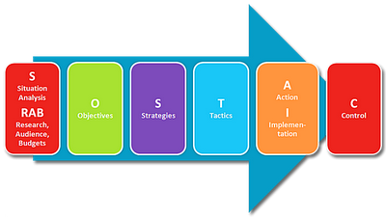
SOSTAC
Situation
Objective
Strategy
Tacticts
Actions
Control

Slide 4
SITUATION
Strength:
7 good properties in the center of India
Potential of maximizing the revenue
Potential to reach a big audience out there via website
Some few information on direction were provided only for one Resort Khana

Slide 5
Kanha National Park, Village & P.O: Mocha, Dist. Mandla (Madhya Pradesh) INDIA. Tel.: +91 - 7649 - 277221, 277251 E-mail : sales@tuligroup.com
Tuli Tiger Corridor - Kanha
Nearest Town | : | Mandla - 65 kms (40 Miles)
Railway Station | : | Nagpur - 255 kms (158 miles) Jabalpur - 160 kms (99.5 miles)
Airport | : | Nagpur - 255 kms (158 miles) Jabalpur - 160 kms (99.5 miles)
By Road | : | Entry in to the park is from Khatia-Kisli & Mukki only. State transport buses are available from Jabalpur. Taxi's / jeeps are available at Nagpur & Jabalpur

Slide 6
Weakness:
No consistency in delivering information to clients
Some properties are important than others
No clear directions of how to get to their properties
Does not indicate different means of transportation either by public or private

Slide 7
OBJECTIVES
Customer satisfaction
Inform the customers about Tuli Hotels& Resort
Facilitate them to get to Tuli properties in all ways
Beat the competition with other hotels in India
Build and maintain a high profile in the eyes of customers

Slide 8
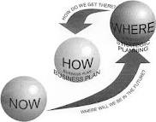
STRATEGY
Well design their website to be attractive in the eyes of visitors who are potential sellers and consumers
A corporate business model would be beneficial with tour and travel agencies and ailines in India

Slide 9
TACTICS
Sign a contract with local travel agents to facilitate Tuli guests and get transport them in the name of Tuli Hotels then charge the Hotel.
Offering special tickets to get to Tuli properties with their Logo and info to a kind of small card for the public transportation.
Get car dealers for those who want to drive themselves while staying with Tuli Hotels and Resorts.

Slide 10
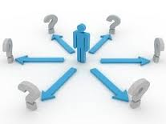
ACTIONS
Marketing team should:
Build Tuli Hotels and Resorts web page dedicated to how customers would get to their properties
Include the geographical locations of their properties using clear maps.
Include directions for those coming via airlines from tall nearby airports to each property of Tuli Hotel
Include directions of those using Trains
Include directions by car
Include possible prices converted into $/GBP/depending on the target market

Slide 11
…………..
Link the clients to the travel agents contracted with Tuli Hotels
Link them to car dealers and get them paid via Tuli Hotels
Link the get to us web page to Google maps in the area of Tuli properties.
Get the website page updated with new information all the times of what is the new travel agent in the area,etc…. And
Vary the design of the webpage to make it more attractive to visitors with nice pictures and offer packages.(transport to be paid with accommodation at the Hotel…)
Link this webpage to social media networks,facebook,twitter,my space,tripadvisor, to listean to the voice of costumers

Slide 12
CONTROL
The control measures of the importance and use of this website could be
Measuring customer satisfaction Via social media ,Tripadvisors,facebook comments
How many clients got to tuli hotel via the travel and airlines recommended on this webpage
How much the business of Tuli tickets in local circulation have given
How many people visited the web page through the click system.

Slide 13
